Slide 1
Modifying Layer Activations
Landon Buell
2 April 2020

Slide 2
The Problem
How does changing Layer Activations affect the performance of a Multi-Layer Perceptron Classifer?

Slide 3
Layer Activations
Simulate approximate computations
Simulate behavior on ‘New’ activation functions
Analyze what problem may arise
Analysze what solutions may arise
What happens when we manipulate the activations?

Slide 4

MLP Classifier Architecture
Series of Repeated Matrix – Vector Products
$${\vec{x}}^{(l+1)}=f[ {\hat{W}}^{\left(l\right)}{\vec{x}}^{\left(l\right)}+{\vec{β}}^{(l)}]$$
This is the general process for forward propagation

Slide 5
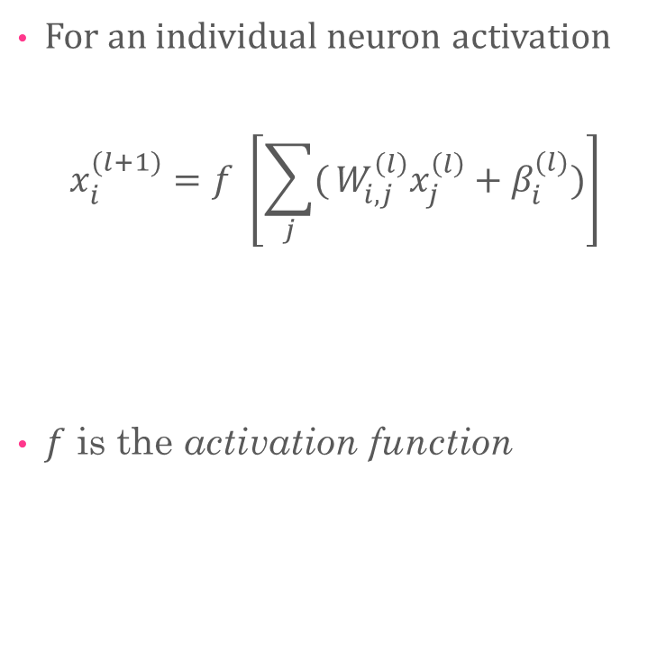
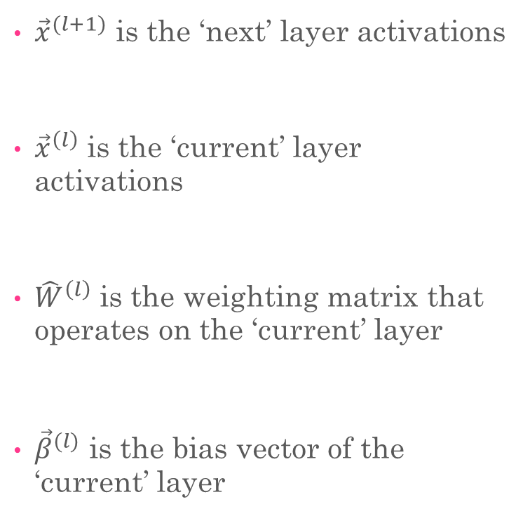
Conventions
${\vec{x}}^{(l+1)}$ is the ‘next’ layer activations
${\vec{x}}^{\left(l\right)}$ is the ‘current’ layer activations
${\hat{W}}^{\left(l\right)}$ is the weighting matrix that operates on the ‘current’ layer
${\vec{β}}^{(l)}$ is the bias vector of the ‘current’ layer
For an individual neuron activation
$$x_{i}^{(l+1)}=f \left[\sum_{j}{(}W_{i,j}^{\left(l\right)}x_{j}^{\left(l\right)}+β_{i}^{(l)})\right]$$
$f$ is the activation function

Slide 6

Quick Example
MLP with two hidden layers:
$${\vec{x}}^{\left(3\right)}=f\left[{\hat{W}}^{2} f\left[{\hat{W}}^{1} f\left[ {\hat{W}}^{0}{\vec{x}}^{0}\right]+{\vec{β}}^{0}\right]+{\vec{β}}^{1}\right]+{\vec{β}}^{2}]$$
Recall ${\vec{x}}^{0}$ is the input feature vector
Original data given to a model
Recall ${\vec{x}}^{3}$is the final output of the model

Slide 7
Forward Pass
The core operation is matrix multiplication
Vector additional is also used
Activation functions act on the resultant linear combination
What happens when we manipulate the output of matrix multiplication?

Slide 8
Experimental Setup
Creating the Models

Slide 9
Experimental Data Set
MNIST Data Set
784 Input Features – 10 Output Classes
Use first 10,000 sample for training
Next 5,000 samples for evaluation

Slide 10
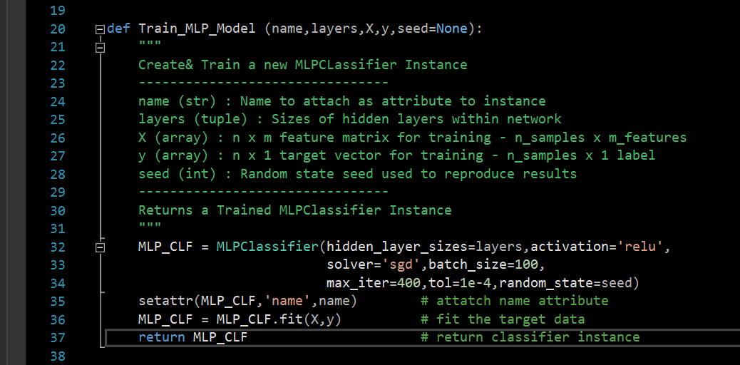
Creating Models
We create and train a series of Neural Network Models
Set Common Hyperparameters
ReLU Activation Function
Stochastic Gradient Descent
100 Sample Minibatch Size
400 Iterations Maximum
0.0001 Tolerance
New random state each iteration

Slide 11
Creating Models
Model Number | Output Layer Size | Layer 3 Size | Layer 3 Size | Layer 2 Size | Layer 1 Size | Input Layer Size
1 | 10 | - | - | - | - | 784
2 | 10 | - | - | - | 20 | 784
3 | 10 | - | - | - | 100 | 784
4 | 10 | - | - | 20 | 20 | 784
5 | 10 | - | - | 100 | 100 | 784
6 | 10 | 20 | 20 | 20 | 20 | 784

Slide 12
Data From Each Model
Name of Model , Training Time , Layer Sizes , Loss Function value , Iterations to train (5 values)
Precision / Recall Scores from each class (20 values)
All 100 elements from standard confusion matrix
125 samples from each model

Slide 13
Experimental Results
Creating, Training & Testing the Models

Slide 14
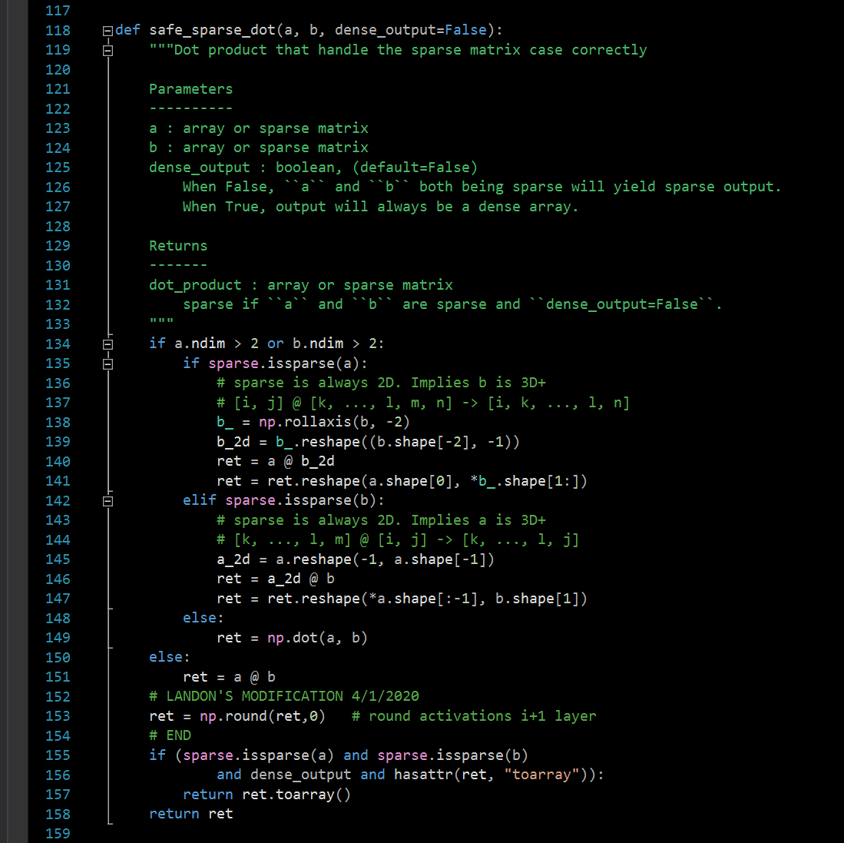
The First Modification
Change Matrix Multiplication
(Round to 0 decimals)
This represents an attack at a very low level
Changes forward pass equation
Will not be accounted for in Back propagation?

Slide 15
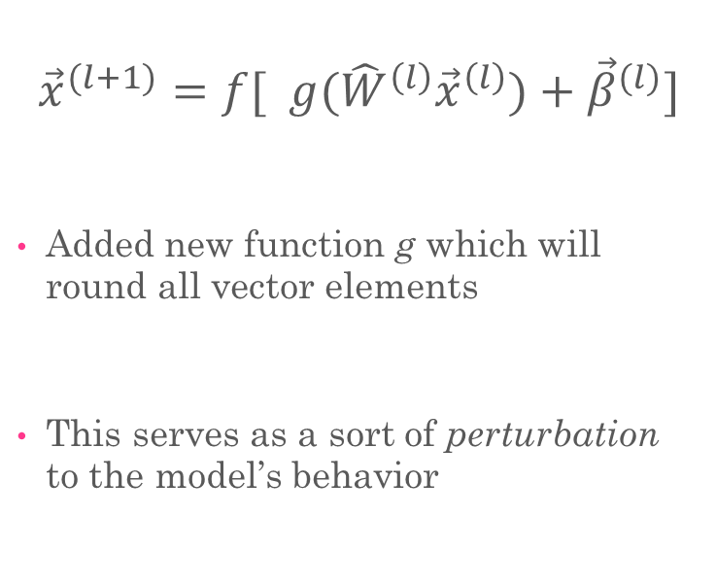
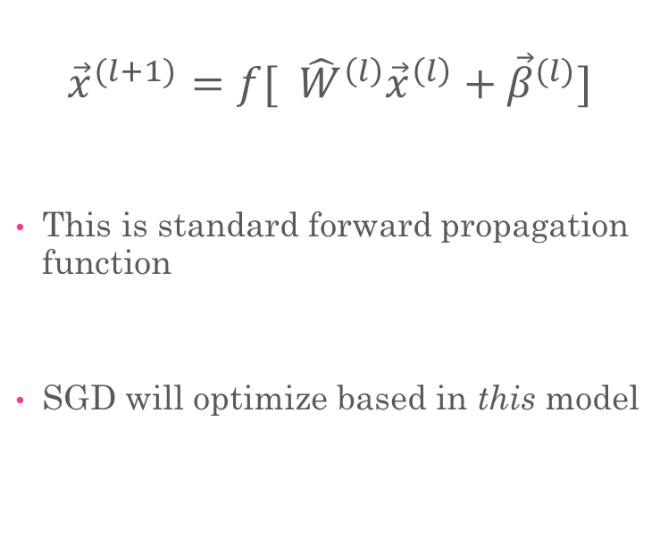
Behavior of New Model
Original Forward Pass
New Forward Pass
$${\vec{x}}^{(l+1)}=f[ {\hat{W}}^{\left(l\right)}{\vec{x}}^{\left(l\right)}+{\vec{β}}^{(l)}]$$
This is standard forward propagation function
SGD will optimize based in this model
$${\vec{x}}^{(l+1)}=f[ g({\hat{W}}^{\left(l\right)}{\vec{x}}^{\left(l\right)})+{\vec{β}}^{(l)}]$$
Added new function g which will round all vector elements
This serves as a sort of perturbation to the model’s behavior

